Slide 1

Adventure works report 2010-2014

Slide 2
Objectives
Provide actionable insights for business decisions.
Identify key contributors to profit and sales performance.
Understand seasonal and regional trends in both profit and sales.
Support strategic planning, including customer targeting and product focus.
Enable efficient data-driven decision-making through interactive visuals.

Slide 3
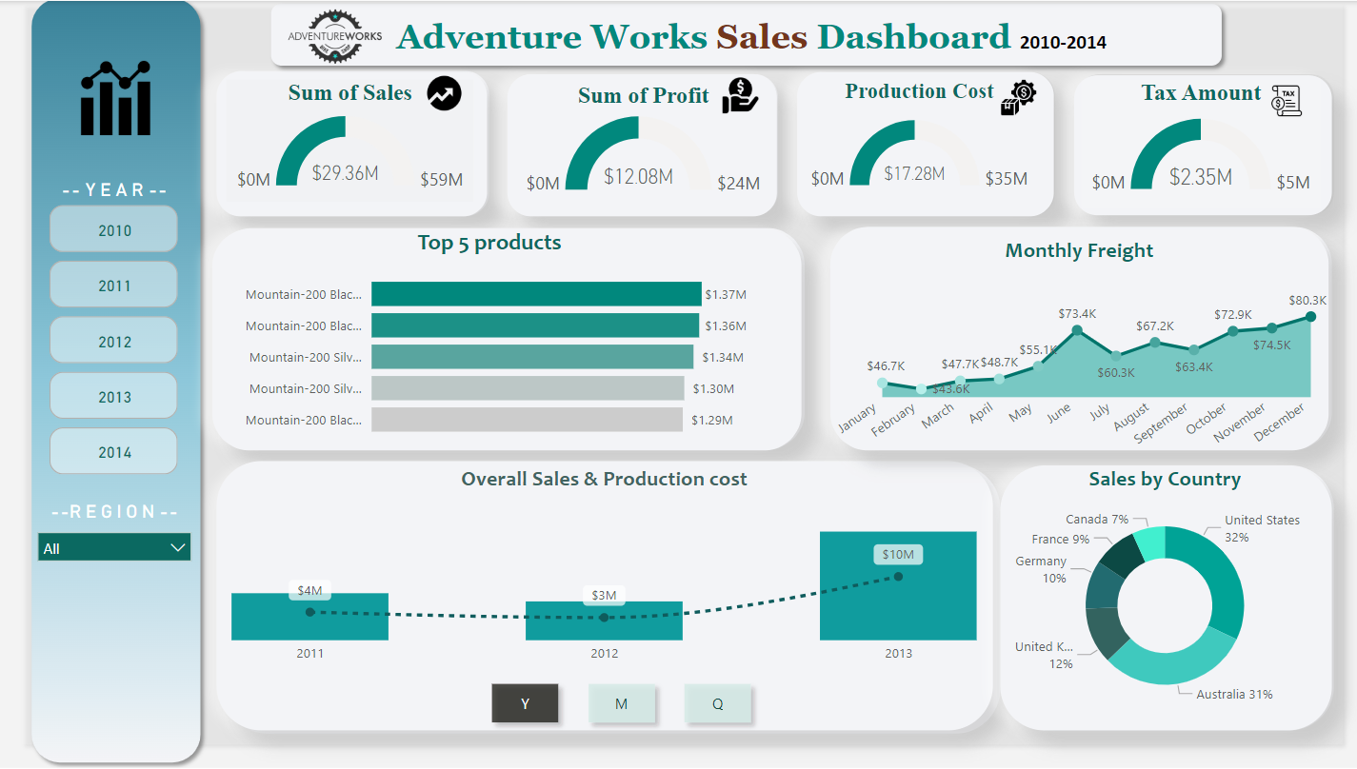

Slide 4
Key Takeaways
Sales and profit grew significantly, reaching $30M and $12M, indicating a strong upward trend.
Mountain 200 Black led sales in 2011 and 2014, with Mountain 2011 Black and Mountain 200 Silver also popular.
Freight costs peaked in 2011, 2013, and July, reflecting seasonal trends and higher shipping volumes.
The US and Australia drive 63% of sales, highlighting strong markets with growth potential in Canada, France, and Germany.

Slide 5
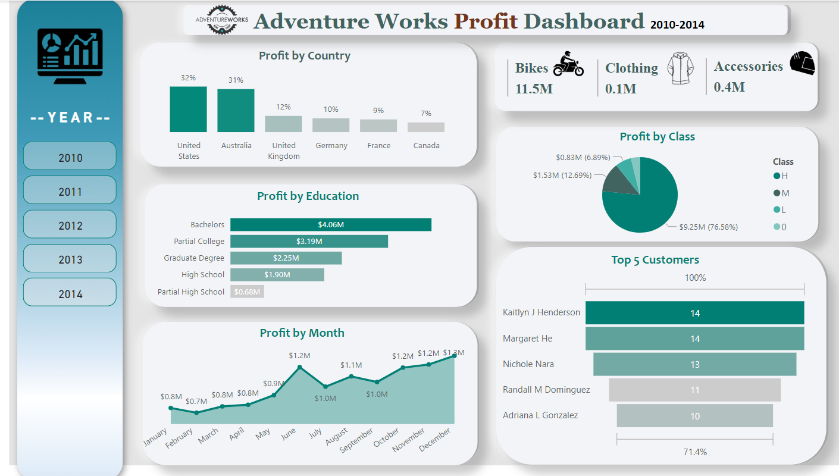

Slide 6
Key Takeaways
The US and Australia contribute over 60% of profit, indicating strong market presence and investment potential.
Bikes lead in profit, while Clothing and Accessories lag, suggesting a focus on boosting lower-performing categories or sustaining Bikes' success.
Customers with Bachelor's and Partial College education are most profitable, guiding targeted marketing efforts.
Profit steadily increases throughout the year, with peaks in June and December, likely due to seasonal demand.
Top customers, like Kaitlyn J Henderson and Margaret He, contribute significantly to profit, emphasizing the need to maintain strong relationships and offer loyalty incentives to retain them.

Slide 7

summary

Slide 8
Focus on weekday promotions, especially Tuesdays and Wednesdays, to maximize profits, while developing strategies to boost weekend sales.
Expand efforts in underperforming regions like Canada and France to tap into untapped potential.
Prioritize Q4 (October to December), with a particular focus on November to maximize profit potential.
Leverage top-selling items, such as the Mountain-200 series, by launching complementary products or upgrades.
Replenish low-stock colors and implement sustainable practices to attract environmentally conscious customers.
Analyze pricing strategies for products under $150 and above $150, offering discounts or bundling for higher-priced items while targeting high-value customers for loyalty and spending growth.

